Slide 1


PYTHON PROJECT
WEATHER FORECAST

Slide 2

CONTENT
1 | Introduction
2 | Technologies Used
3 | Project Structure
4 | GUI Design
6 | Error Handling
7 | Icon Management
8 | Code Snippets
9 | Fetching Weather Data
5
Fetching Weather Data
10
Thank You

Slide 3



INTRODUCTION
Overview
  WeatherOcast is a Python-based application designed to provide real-time weather updates.
  Users can enter a city name to retrieve current weather conditions and forecasts.
Purpose
  To create a user-friendly interface for accessing weather information quickly and easily.

Slide 4

TECHNOLOGIES USED
Programming Language:
PYTHON
Libraries:
  CustomTkinter: For a modern and customizable graphical user interface.
  Requests: To handle HTTP requests for API calls.
  Pillow (PIL): For image processing and handling weather icons.
API:
  OpenWeatherMap: Provides weather data through a robust API.

Slide 5



PROJECT STRUCTURE
Main Components:
  GUI Setup: Utilizing CustomTkinter to create the application layout.
  API Integration: Fetching weather data based on user input.
  Error Handling: Ensuring a smooth user experience by managing potential errors.

Slide 6
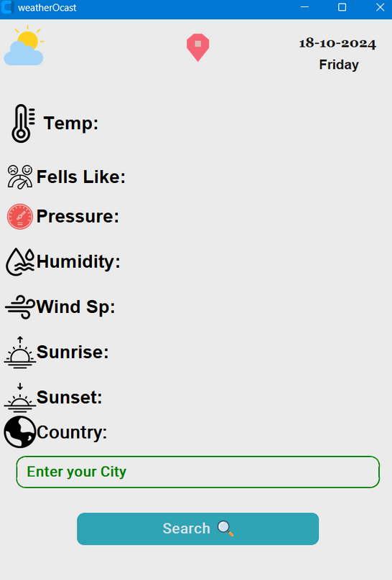
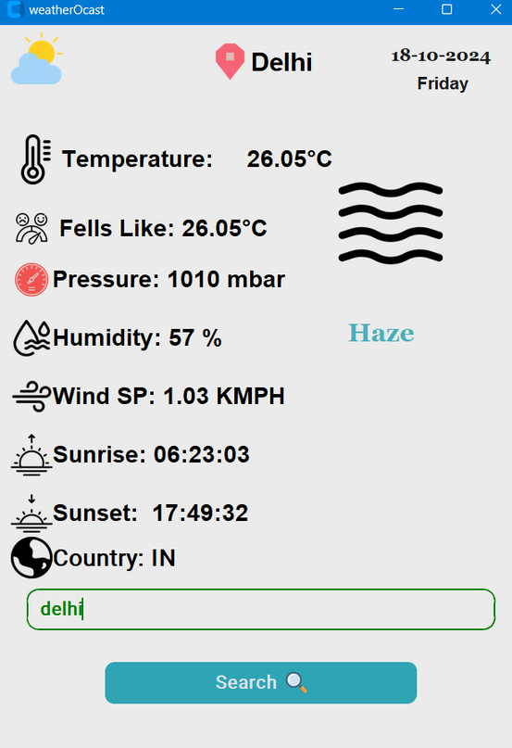
GUI DESIGN
Layout:
  City Input Field: Where users type in the name of the city.
  Display Area: Shows weather data, including temperature, humidity, etc.
  Search Button: Triggers the weather data retrieval process.
Dynamic Elements:
  Weather icons change based on current conditions for visual representation.
Home Page
Running Code

Slide 7
FETCHING WEATHER DATA
Function: get_weather()
  Description: Responsible for retrieving weather data from the OpenWeatherMap API.
  Process:
    Get city name: Retrieves user input from the entry field.
    API Request: Constructs the URL and makes a GET request.
    JSON Parsing: Converts the API response into a usable format.
    GUI Update: Displays the retrieved weather information in the app.

Slide 8
ERROR HANDLING
Types of Errors Managed:
  Invalid City Names: Alerts the user if the city name is not recognized.
  Network Issues: Handles exceptions for network-related errors.
  User Feedback:
  Utilizes message boxes to inform users about errors in a clear and friendly manner.

Slide 9




ICON MANAGEMENT
Purpose:
  Icons play a critical role in enhancing user experience by providing immediate visual context.
Usage:
  Weather conditions are represented through specific icons (e.g., sun for clear, clouds for overcast, raindrops for rain).
  Icons accompany labels for metrics like temperature, humidity, and wind speed, making the interface intuitive.
Implementation:
  Utilized the CTkImage class from the customtkinter library to manage icon display.
  Icons are loaded from local files and resized appropriately for the GUI layout.

Slide 10
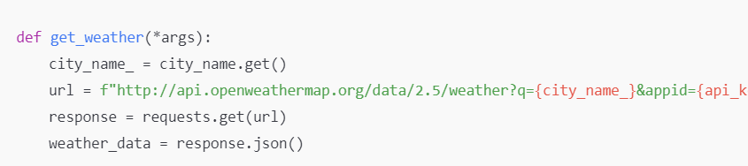
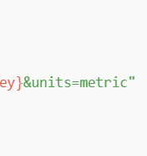

CODE SNIPPETS
Fetching Weather Data:
  The function that makes the API call to retrieve weather data based on user input.
  Uses the requests library to handle HTTP requests.
Uses the requests library to call the OpenWeatherMap API.

Slide 11

FETCHING WEATHER DATA
Process:
  When the user enters a city name and hits "Search," the application triggers the get_weather function.
Data Handling:
  The function checks the response code to ensure valid data retrieval.
  Extracts essential weather information such as temperature, pressure, humidity, and more from the response.
Display:
  The UI is updated dynamically with the fetched data, ensuring users have the latest weather information.
checks if the API response indicates a successful request.

Slide 12
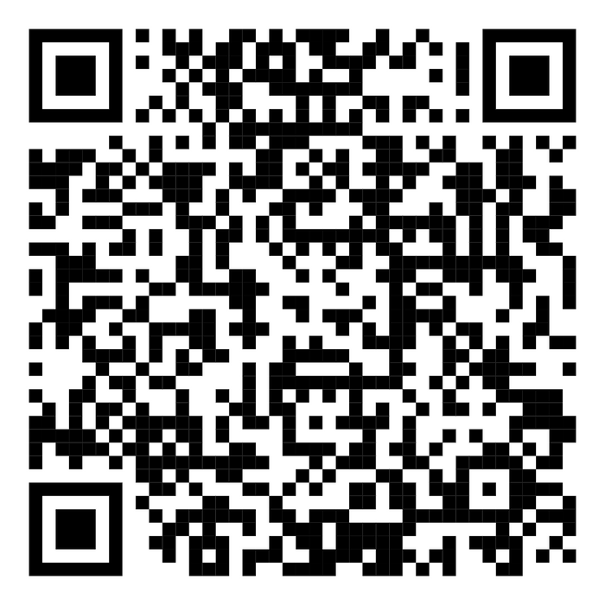
GITHUB REPOSITORY
Feel free to contribute to the project by opening issues or submitting pull requests!
https://github.com/YashGarg1122/WeatherForecast.git

Slide 13



Set up API, interface design
Lead developer, account management
Project management
Error handling, testing, database design
Documentation, UI Design
Git management, database setup

Slide 14
THANK YOU

